Slide 1
Logistic Regression

Slide 2
Logistic regression
Logistic regression is a statistical method for analysing a dataset in which there are one or more independent variables that determine an outcome. The outcome the Dependant Variable is measured with a dichotomous variable (in which there are only two possible outcomes).
It is customary to code a binary Dependant Variable either 0 or 1. For example, we might code
a successfully kicked field goal as 1 and a missed field goal as 0 or
yes as 1 and no as 0 or
admitted as 1 and rejected as 0 or
Cherry Garcia flavour ice cream as 1 and all other flavours as zero.
If we code like this, then the mean of the distribution is equal to the proportion of 1s in the distribution.
For example if there are 100 people in the distribution and 30 of them are coded 1, then the mean of the distribution is .30, which is the proportion of 1s.
The mean of the distribution is also the probability of drawing a person labelled as 1 at random from the distribution.

Slide 3
Why use logistic regression rather than ordinary linear regression?
If you use linear regression, the predicted values will become greater than one and less than zero if you move far enough on the X-axis. Such values are theoretically inadmissible.
One of the assumptions of regression is that the variance of Y is constant across values of X (homoscedasticity). This cannot be the case with a binary variable, because the variance is PQ. When 50 percent of the people are 1s, then the variance is .25, its maximum value. As we move to more extreme values, the variance decreases. When P=.10, the variance is .1*.9 = .09, so as P approaches 1 or zero, the variance approaches zero.
The significance testing of the b weights rest upon the assumption that errors of prediction (Y-Y') are normally distributed. Because Y only takes the values 0 and 1, this assumption is pretty hard to justify, even approximately.
Therefore, the tests of the regression weights are suspect if you use linear regression with a binary DV.

Slide 4
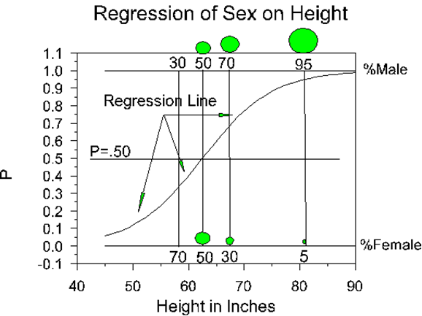
The mean of a binary distribution so coded is denoted as P, the proportion of 1s. The proportion of zeros is (1-P), which is sometimes denoted as Q. The variance of such a distribution is PQ, and the standard deviation is Sqrt(PQ)
Suppose we want to predict whether someone is male or female (DV, M=1, F=0) using height in inches (IV). We could plot the relations between the two variables as we customarily do in regression. The plot might look something like this:
Points to notice about the graph (data are fictional):
The regression line is a rolling average, just as in linear regression. The Y-axis is P, which indicates the proportion of 1s at any given value of height.
The regression line is nonlinear.
None of the observations --the raw data points-- actually fall on the regression line. They all fall on zero or one

Slide 5
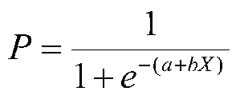
The Logistic Curve
The logistic curve relates the independent variable, X, to the rolling mean of the DV, P ($\overline{Y)}$. The formula to do so can be written as
where P is the probability of a 1 (the proportion of 1s, the mean of Y), e is the base of the natural logarithm (about 2.718) and a and b are the parameters of the model.
The value of a yields P when X is zero, and b adjusts how quickly the probability changes with changing X a single unit. Because the relation between X and P is nonlinear, b does not have a straightforward interpretation in this model as it does in ordinary linear regression.

Slide 6
Loss Function
A loss function is a measure of fit between a mathematical model of data and the actual data.
We choose the parameters of our model to minimize the badness-of-fit or to maximize the goodness-of-fit of the model to the data. With least squares , we minimize SS_{res}, the sum of squares residual. This also happens to maximize SS_{reg}, the sum of squares due to regression. With linear or curvilinear models, there is a mathematical solution to the problem that will minimize the sum of squares, that is,
b = (X'X)⁻¹X'y
With some models, like the logistic curve, there is no mathematical solution that will produce least squares estimates of the parameters.
For many of these models, the loss function chosen is called maximum likelihood.
A likelihood is a conditional probability (e.g., P(Y|X), the probability of Y given X).

Slide 7
We can pick the parameters of the model (a and b of the logistic curve) at random or by trial-and-error and then compute the likelihood of the data given those parameters.
We will choose as our parameters, those that result in the greatest likelihood computed. The estimates are called maximum likelihood because the parameters are chosen to maximize the of the sample data.
There are several methods of numerical analysis, but they all follow a similar series of steps. First, the computer picks some initial estimates of the parameters. Then it will compute the likelihood of the data given these parameter estimates. Then it will improve the parameter estimates slightly and recalculate the likelihood of the data. It will do this forever until we tell it to stop, which we usually do when the parameter estimates do not change much (usually a change .01 or .001 is small enough to tell the computer to stop). [Sometimes we tell the computer to stop after a certain number of tries or iterations, e.g., 20 or 250. This usually indicates a problem in estimation.]

Slide 8

Where on Earth Did This Stuff Come From?
Suppose we only know a person's height and we want to predict whether that person is male or female. We can talk about the probability of being male or female, or we can talk about the odds of being male or female.
Let's say that the probability of being male at a given height is .90. Then the odds of being male would be
(Odds can also be found by counting the number of people in each group and dividing one number by the other.
Clearly, the probability is not the same as the odds.) In our example, the odds would be .90/.10 or 9 to one. Now the odds of being female would be .10/.90 or 1/9 or .11.
This asymmetry is unappealing, because the odds of being a male should be the opposite of the odds of being a female.
We can take care of this asymmetry though the natural logarithm, ln. The natural log of 9 is 2.217 (ln(.9/.1)=2.217). The natural log of 1/9 is -2.217 (ln(.1/.9)=-2.217), so the log odds of being male is exactly opposite to the log odds of being female.

Slide 9
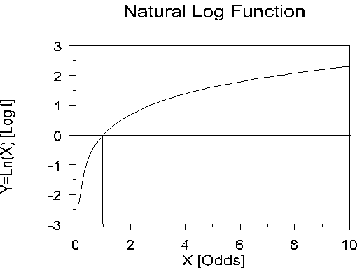
natural log function
The natural log function looks like this:
Note that the natural log is zero when X is 1. When X is larger than one, the log curves up slowly. When X is less than one, the natural log is less than zero, and decreases rapidly as X approaches zero. When P = .50, the odds are .50/.50 or 1, and ln(1) =0. If P is greater than .50, ln(P/(1-P) is positive; if P is less than .50, ln(odds) is negative. [A number taken to a negative power is one divided by that number, e.g. e⁻¹⁰ = 1/e^{10.} A logarithm is an exponent from a given base, for example ln(e¹⁰) = 10.]

Slide 10

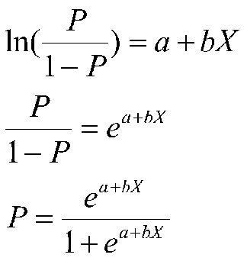
In logistic regression, the dependent variable is a logit, which is the natural log of the odds, that is,
Which is assumed to be linear, that is, the log odds (logit) is assumed to be linearly related to X, our Independent Variable. So there's an ordinary regression hidden in there. We could in theory do ordinary regression with logits as our Dependant variable, but of course, we don't have logits in there, we have 1s and 0s.

